Slide 1
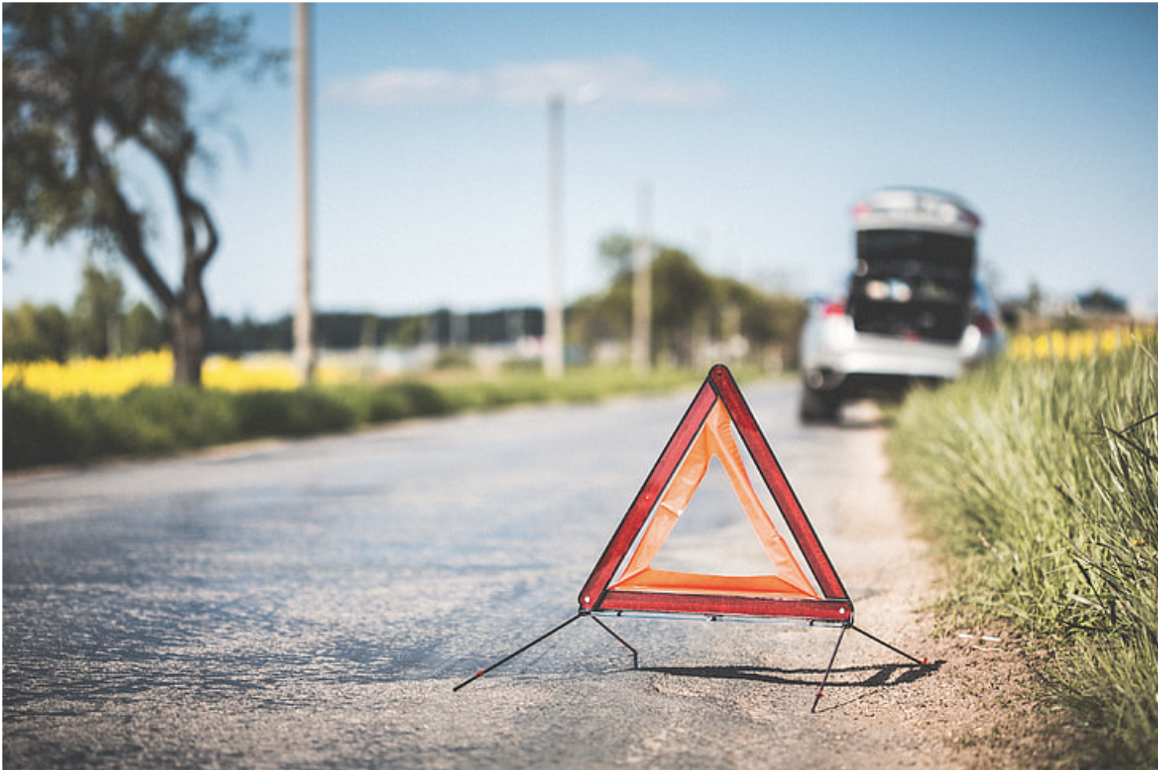


Predicting Severity of road accidents Elizabeth Kelley, Jack Wagner, Supriyo Ghosh, Tristan Freiberg
THE ERDŐS INSTITUTE
DATA SCIENCE BOOTCAMP, SPRING 2024
GitHub Repository

Slide 2
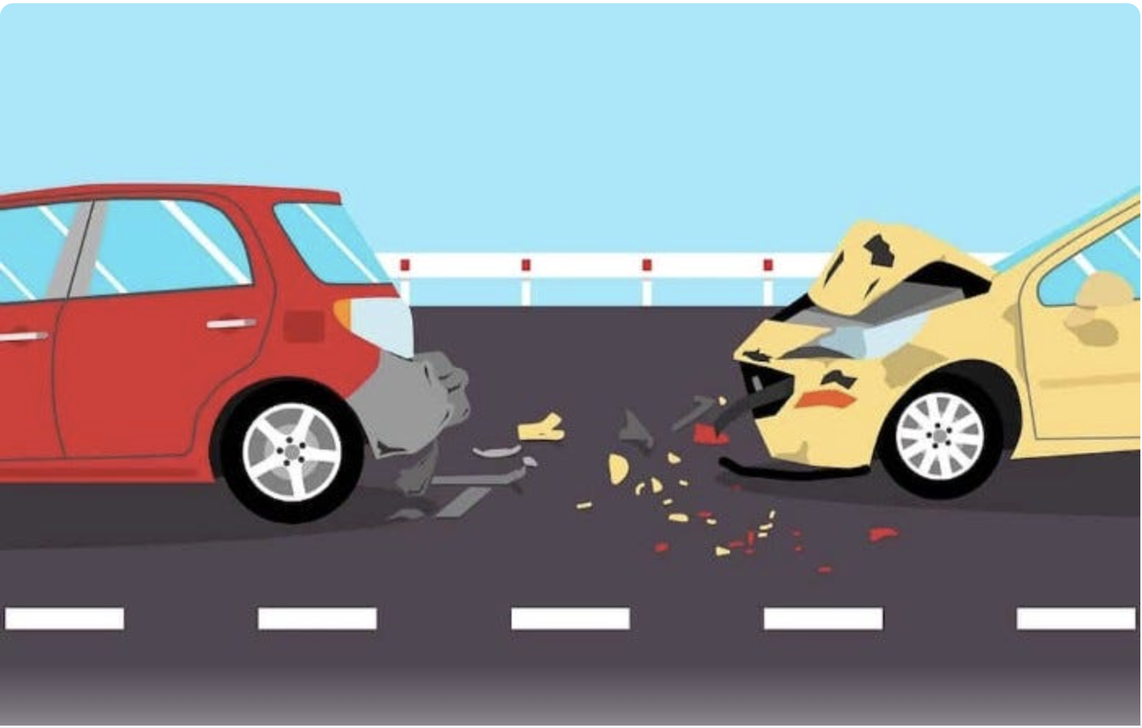
Introduction
Road accidents could be avoided or be less severe in certain conditions of the road

Slide 3
Data collection
We use the accident reports from QUEBEC AUTOMOBILE INSURANCE SOCIETY (SAAQ) for last 10 years.
Data from accident reports completed by police officers, including the time, severity of the accident as well as the type of vehicles involved.

Slide 5
Models Used
Models used: Baseline, Logistic, Random Forest, SVM, XGBoost
Final model: XGBoost with upsampling
 | Predicted
Actual | 0 | 1 | 2 | Total
0 | 29598 | 7862 | 2092 | 39552
1 | 2555 | 4289 | 2744 | 9588
2 | 62 | 88 | 277 | 427
Total | 32215 | 12239 | 5113 | 49567
 | F2 score: 0.689

Slide 6
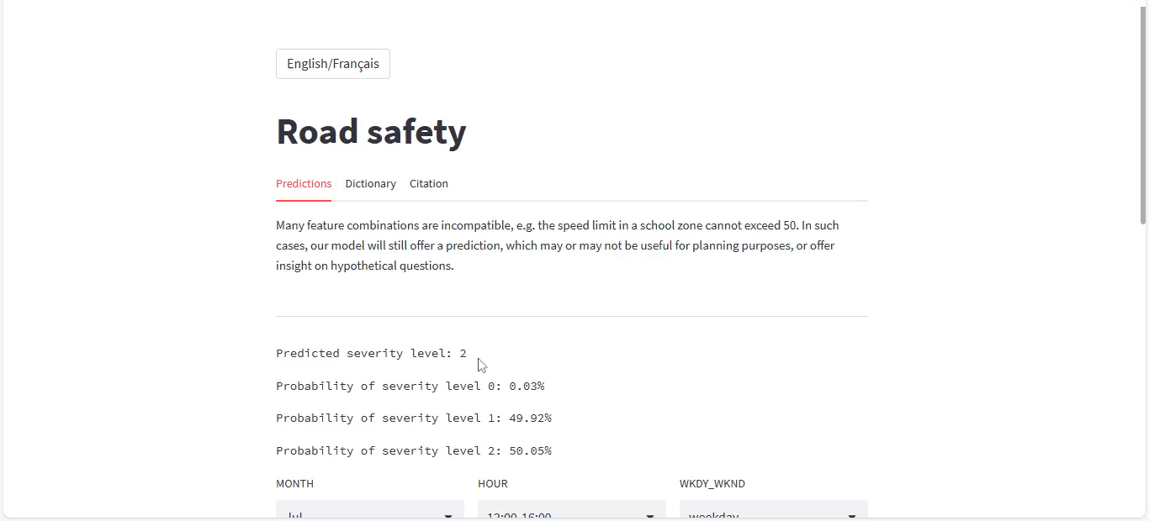
Streamlit application

Slide 7
Potential Future Directions
Test model on traffic data from different areas
Source traffic data with different variables to try to improve predictions
Create a tool for emergency vehicle dispatchers to allocate appropriate resources
Use model to make recommendations to city governments to improve areas with high accident severity

Slide 8
We thank the Erdős Institute for the opportunity and the support!

